Slide 1
Protein structure prediction via combinatorial assembly of sub-structural units
Yuval Inbar , Hadar Benyamini, Ruth Nussinov and Haim J. Wolfson
Bioinformatics Vol. 19 Suppl. 1 2003 Pages i158-i168

Slide 2
INTRODUCTION
Currently, there are three major strategies for protein structure prediction:
1.homology modeling
2.fold recognition
3.ab initio prediction.

Slide 3
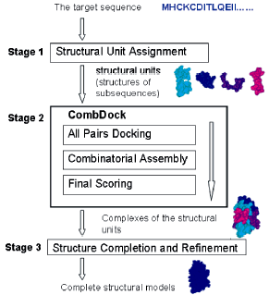
Protein structure prediction scheme

Slide 4
Protein structure prediction scheme
1st stage: a target sequence is cut into disjoint segments. Each segment is assigned a structural model.
2nd stage: the combinatorial assembly, gets as an input the structural models that were output by the first stage. It assembles them in an attempt to predict their relative 3D complexes.
3rd stage: a completion and refinement of highly ranked models is performed.

Slide 5
COMBDOCK CONCEPT AND ALGORITHM
The input consists of an ordered set of N SUs(structural units) of a protein.
The SUs are considered rigid bodies and can only be rotated and translated with respect to each other.
In principle the assembly of SUs into one 3D complex is similar to the problem of solving a 3D jigsaw puzzle where the protein SUs are the puzzle pieces.

Slide 6
COMBDOCK : All pairs docking
We have developed a docking algorithm that is a hybrid of two docking algorithms, Norel et al. (1995) and Polak (2002).
The algorithm analyzes the surface of the two molecules (SUs) that it docks and by matching complementary local features, it calculates candidate transformations.
For each run, the docking algorithm returns a set of 3D transformations
Such a connected pair is considered one piece in the next iteration.
Since we join one pair of pieces at each iteration, after N − 1 iterations we are left with only one piece, which is a complex of all the N original pieces.

Slide 7
COMBDOCK : Combinatorial assembly
This module constructs valid complexes by using only the input transformations generated by the all Pairs Docking module.
We reduce the combinatorial assembly problem to the problem of finding spanning trees in a graph.
Each SU is represented by a vertex and each transformation between two SUs is represented by an edge between the two corresponding vertices.
( eg : SU: i , j , k )
Any spanning tree represents a complex, but the complex might be invalid.
seek the best spanning trees : NP -Complete
( monkey - puzzle)

Slide 8
COMBDOCK : Final scoring
The scoring function combines both geometric and physico-chemical features.

Slide 9
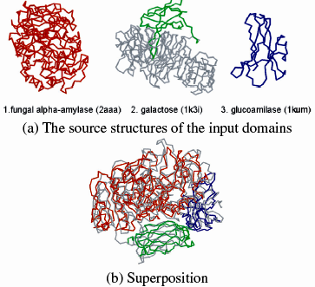
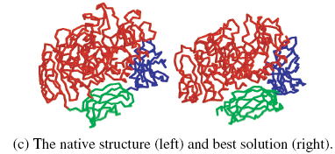
RESULTS

Slide 10
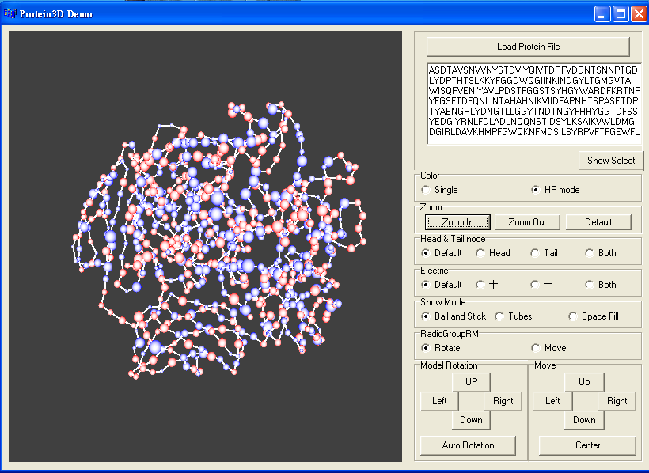

Slide 11
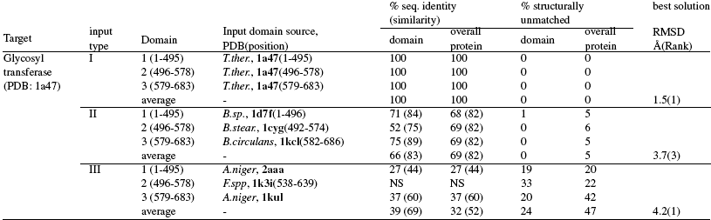
RESULTS
Sequence identity and similarity percentages were calculated using NCBI Blast
NS = not significant.
The structure alignment finds correspondence between ‘matched’ residues, which are within a distance of 2.5 °A when superimposed.

Slide 12
CONCLUSIONS
CombDock may be used in protein structure prediction if the local structural units are given.
The structural units may be predicted models, or experimentally solved substructures.
In both cases, the method may help to obtain a structural model for much larger proteins than the current techniques can handle.

Slide 13
Def:
G = (V,E) , 挑一些 edges E‘ 出來, 與原圖當中所有的 vertices 合起來成為 G’ = (V, E‘) 為 G 的一個 subgraph。
G' 滿足: (1) connected (2) 沒有 cycle
則稱 G' 為 G 的一個 spanning tree

